Slide 1
Software Engineering 2: Poker App
By James Fallon, Ryan Pratt, and Jacob Zahn

Slide 2
Roles
Front End Developer: Ryan Pratt
Back End Developers: Jacob Zahn, James Fallon

Slide 3
Application
Our goal is to create a cross platform application with iOS and Android capabilities to play the poker game blackjack.
We utilize JavaScript within the Vue-Native framework to implement this goal.

Slide 4
Blackjack
Blackjack is played with a traditional 52 card deck against the AI dealer.
The goal of the game is to get a score of 21 or as close as possible to 21. The game is played between the user and dealer and whoever is closer wins the pot bet at the beginning of the round.

Slide 5
Blackjack Features
Aces are counted as 1 or 11, 2 to 10 is according to the pip value, and face cards are counted as 10’s. The player and dealer initially draw two cards and sum together the total.
The player may do the following actions: hit, stand, split, or double down.

Slide 6
Vue-Native
Is the JavaScript based framework we utilized in the project.
It utilizes an HTML-like template to build the layout of the application.
It is a flexible framework that is compatible through multiple platforms.
Built on Facebook’s React Native

Slide 7
Risk Assessment
Utilized open source graphics to avoid running into copy right issues.
Avoid falling under the designation of a gambling application.

Slide 8
Planning
Our group started by brainstorming some ideas before deciding to take on the poker application.
On paper we came up with the components of the game that helped us build the requirements specifications.

Slide 9
Organization
Group meetings and text communication were our main sources of organizing.
Our schedules conflicted but we found time to meet during the allotted group work days and weekends.
GitHub served as the medium of version control.

Slide 10
Development Methods
We took an agile development approach with goal based sprints that we determined whenever we would meet.
Scheduled out benchmarks for these sprints.

Slide 11
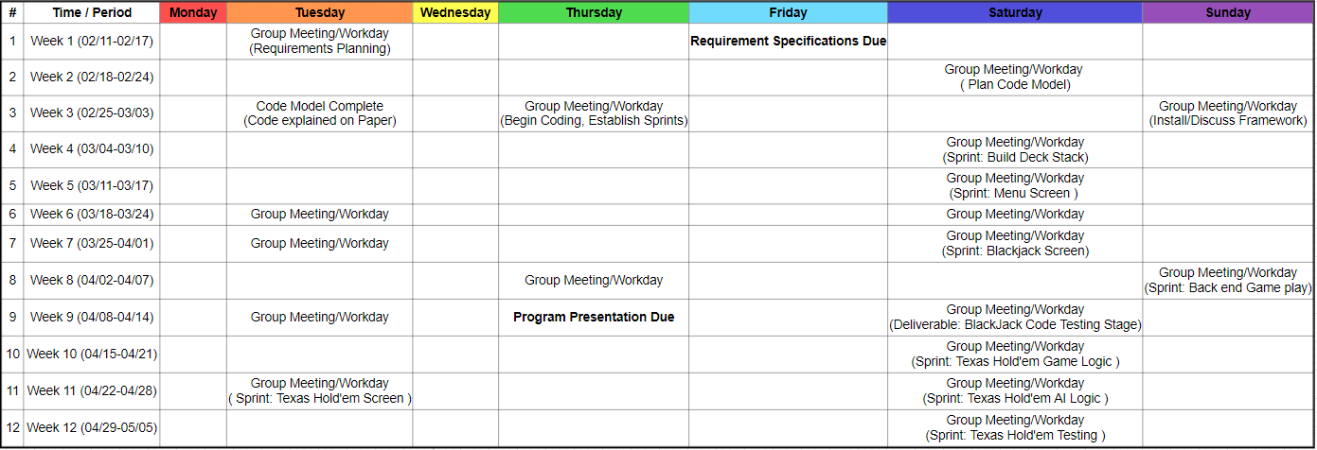
Planning Schedule

Slide 12
Requirements Doc Changes
Texas Hold’em functionality will be limited ( Or removed ) as programming the AI is very complex and we are constrained on time.
Game play/Menu is not as graphically pleasing as initially intended.
Unclear if split option will be added.

Slide 13
Questions?

